Slide 1
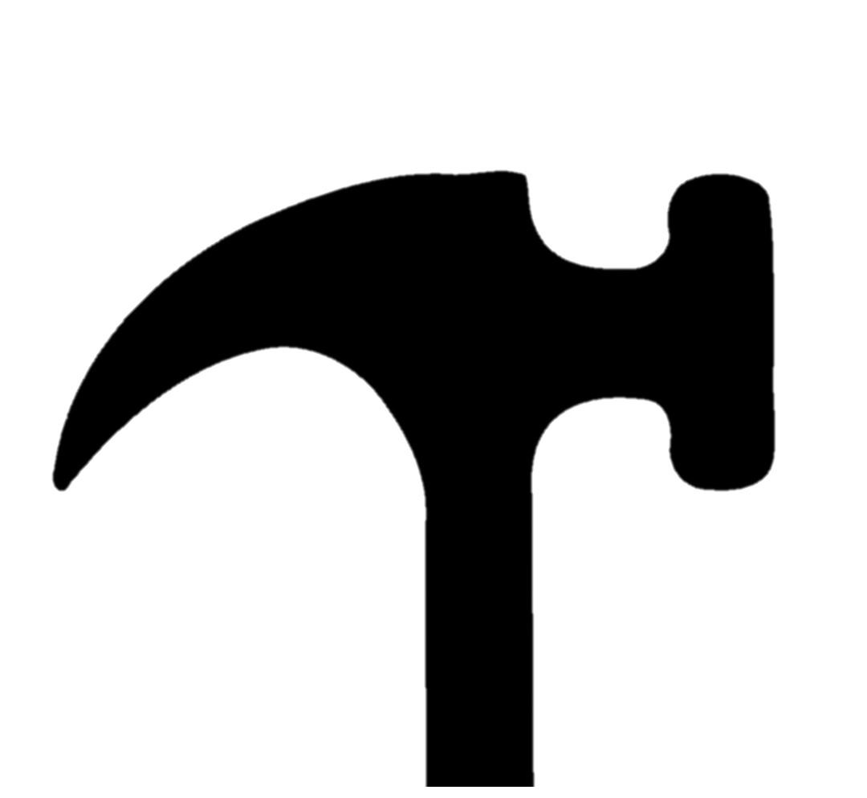
Consider this
You use a hammer to hit these two identical nails with equal force.
The top nail enters the wall. The lower nail bends without puncturing the wall.
Wall
Why do the two nails behave differently, even though you hit them with the same force?

Slide 2
A force of 8200 N is applied evenly to an area of 4 m².
What is the force that acts on each square metre?
8200 N
1 m²
1 m²
1 m²
1 m²

Slide 3
A force of 300 N acts on every square metre of a wooden board.
What is the total force being exerted on the board if its area is 2.5 m²?
300 N
___ N
__N
0.5
m²
1 m²
1 m²

Slide 4
A tabletop experiences a pressure of 2000 N/m².
The force acting on the tabletop is 800 N.
What is the area of the tabletop?
2000 N
800 N
1 m²
__m²
If 1 m² would experience a force of 2000 N, what area would experience a force of 800 N?

Slide 5
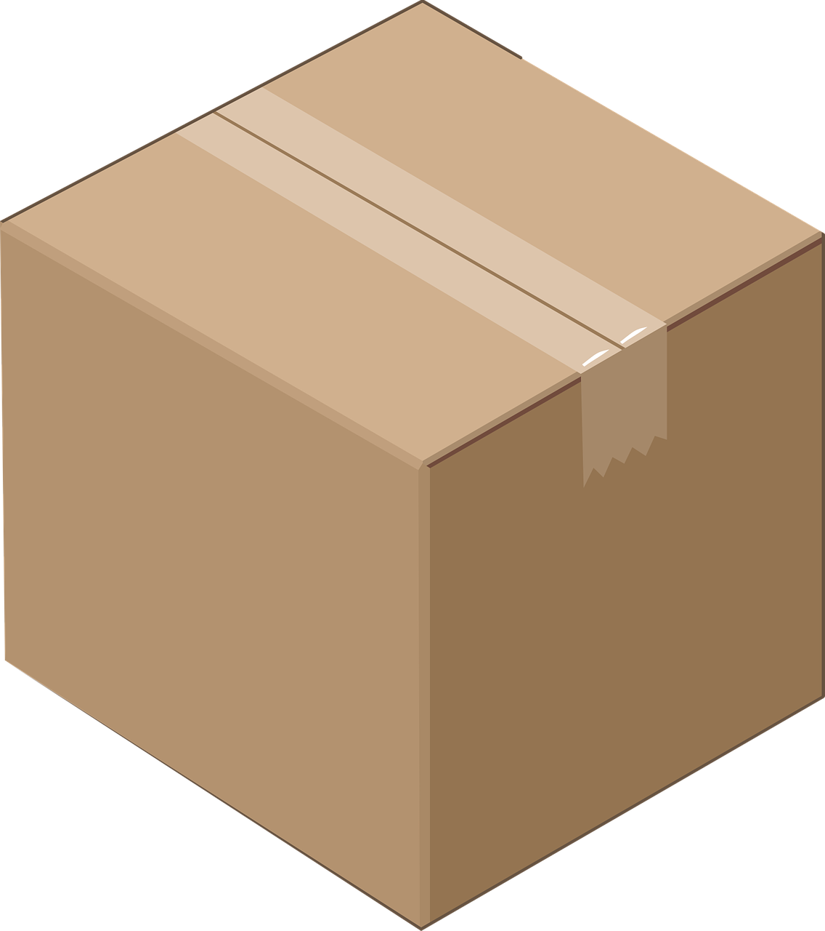
Consider this
Assume these boxes are all the same shape and weight.
Force exerted on the floor by the boxes | 130 | N | 260 | N | 260 | N
Area of boxes in contact with the floor | 1 | m² | 1 | m² | 2 | m²
Pressure on the floor due to the boxes | 130 | N/m² | 260 | N/m² | 130 | N/m²
Click to reveal
Click to reveal
Click to reveal
Click to reveal
Click to reveal
Click to reveal

Slide 6
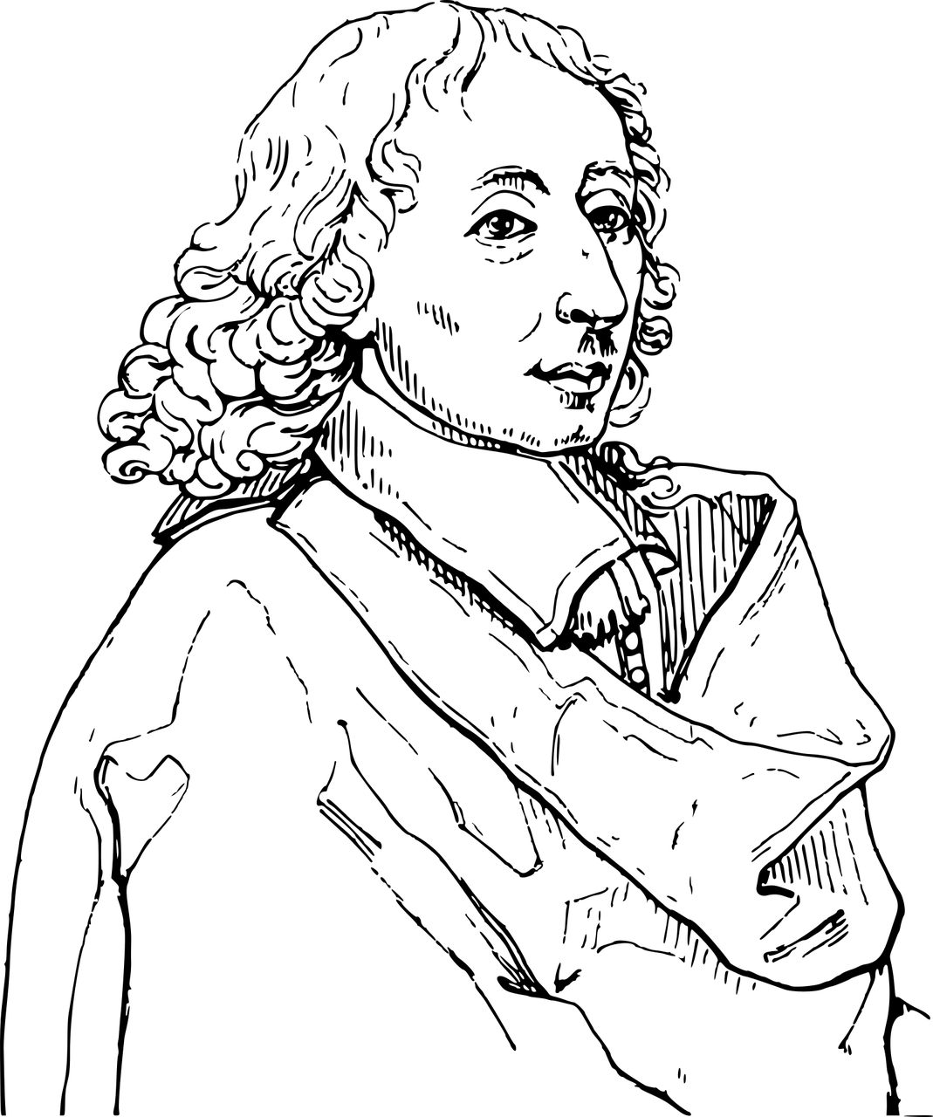
Context
The pascal (Pa) is named after Blaise Pascal, after whom Pascal’s triangle and Pascal’s wager are named.
What do various levels of pressure feel like?
1 N/m² = 1 Pa, which is a very small amount of pressure. A 1 Pa change in pressure would be too small for a human to detect.
Water 1 cm deep in a container causes a pressure of around 100 Pa on the base of the container.
The air pressure at sea level is typically around 100,000 Pa.
The pressure in a car tyre is around 250,000 Pa.

