Slide 1



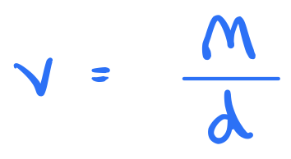

Warm-up activity
m
Here is a formula:
d =
v
Answer
Work out the value of d when m = 18 and v = 3
Rearrange the formula to make m the subject.
Work out the value of m when d = 5 and v = 10
Rearrange the formula to make v the subject.
Work out the value of v when m = 28 and d = 4
Answer
Answer
Answer
Answer

Slide 2
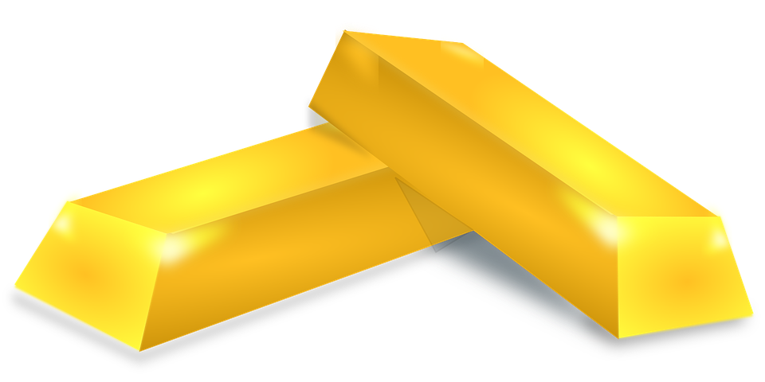
Examples
Density, mass, volume
A cube of side 3 cm has a mass of 54 grams. What is the density of the cube?
Gold has a density of 19.32 g/cm³. How much does 1 m³ of gold weigh?
What is the volume of an object that weighs 1 kg and has a density of 6 g/cm³?

Slide 3

Diagnostic
Which of the following is a correct formula?
a)
Density = Mass × Volume
_{Mass =} Volume
b)
Density
c)
Volume = Mass × Density
Mass
d)
Volume = _{Density}

Slide 4
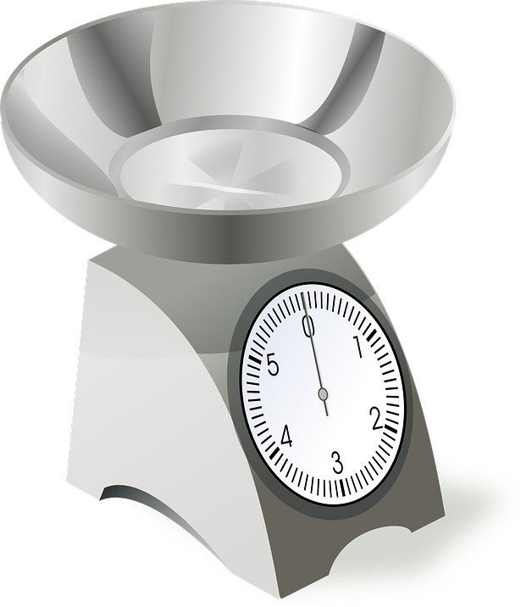
Diagnostic
10 cm³ of aluminium has a mass of 28 g. What is its density?
280 g/cm³
2.8 g/cm³
c) 0.28 kg/m³
d) 0.357 g/cm³

Slide 5
Diagnostic
Sea water has a density of 1.03 g/cm³.
What is the mass of 100 cm³ of sea water?
a) 103 g
b) 0.0103 g
c) 103 kg
d) 97.1 g

Slide 6
Diagnostic
Sea water has a density of 1.03 g/cm³.
What is the volume of 4.12 grams of sea water?
4 g
4 cm³
c) 0.25 cm³
d) 0.25 g/cm³

Slide 7


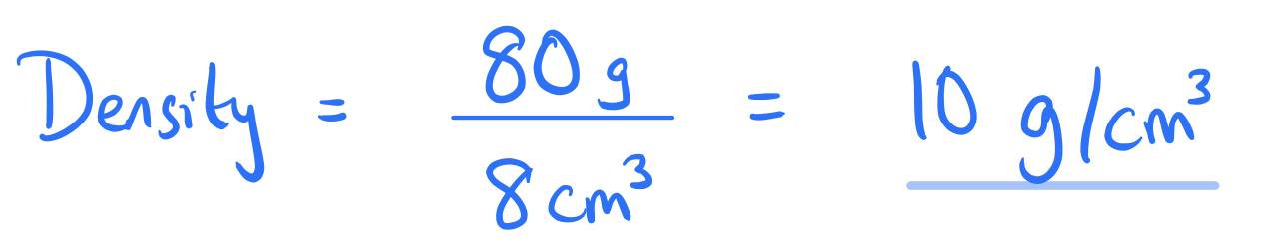
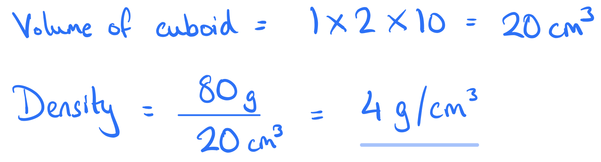
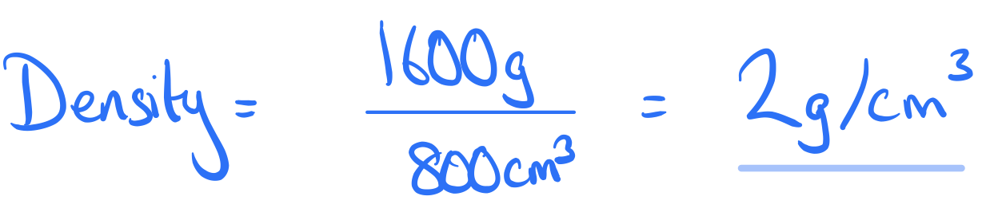
α
Alpha Exercise
Solution
A block with a volume of 8 cm³ weighs 80 g. What is the density of this block in g/cm³?
A 1 cm x 2 cm x 10 cm cuboid weighs 80 grams. What is the
density of the cuboid?
A gym ball with a volume of 800 cm³ has a mass of 1600 g. What is the density of the ball?
Solution
Solution

Slide 8

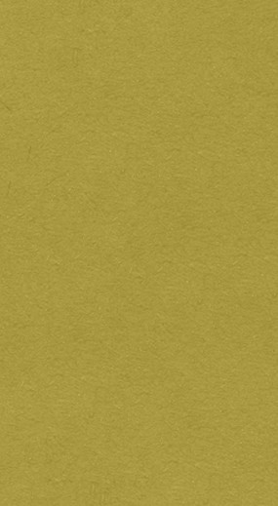
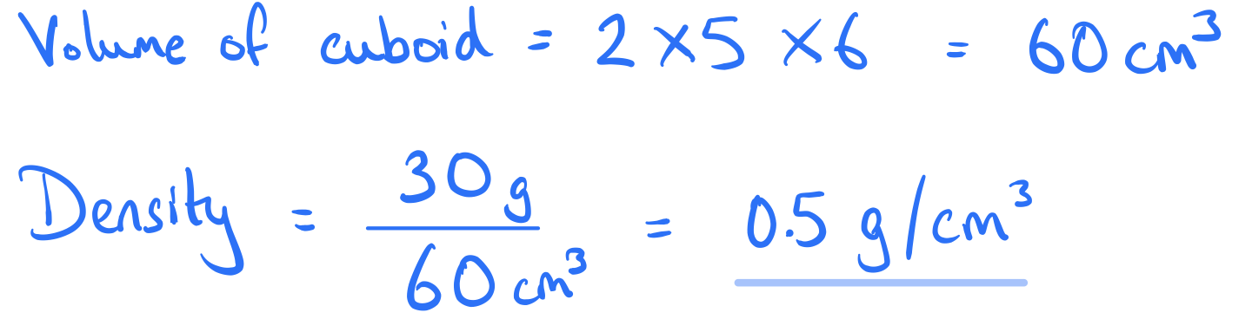
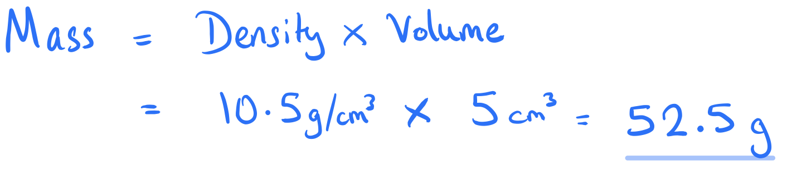
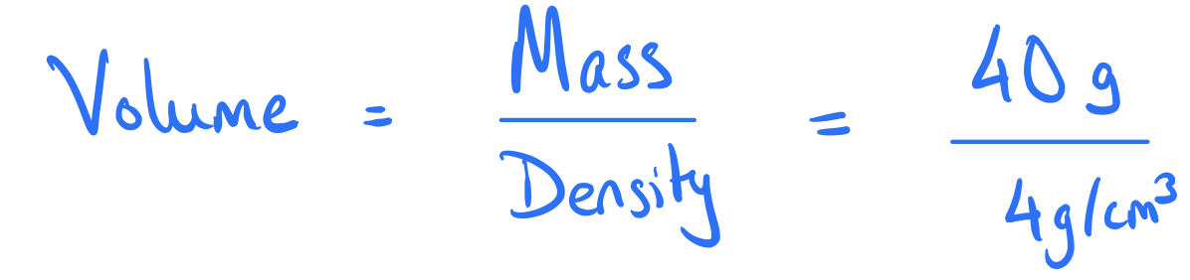
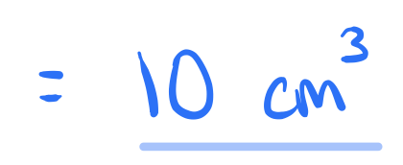
β
Beta Exercise
A 2 cm x 5 cm x 6 cm cuboid weighs 30 grams. What is the density of the cuboid?
Silver has a density of 10.5 g/cm³. How much does 5 cm³ of silver weigh?
What is the volume of an object that weighs 40 g and has a density of 4 g/cm³.
Solution
Solution
Solution

Slide 9


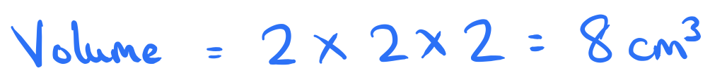
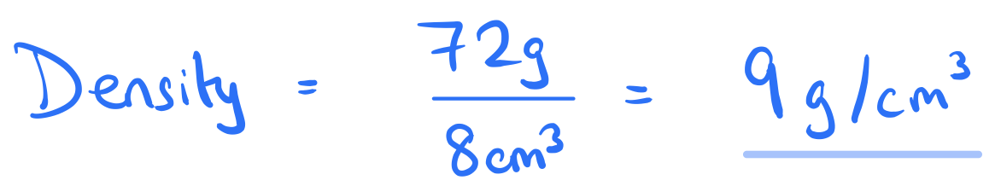
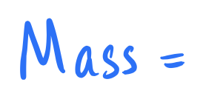
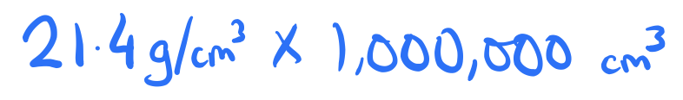

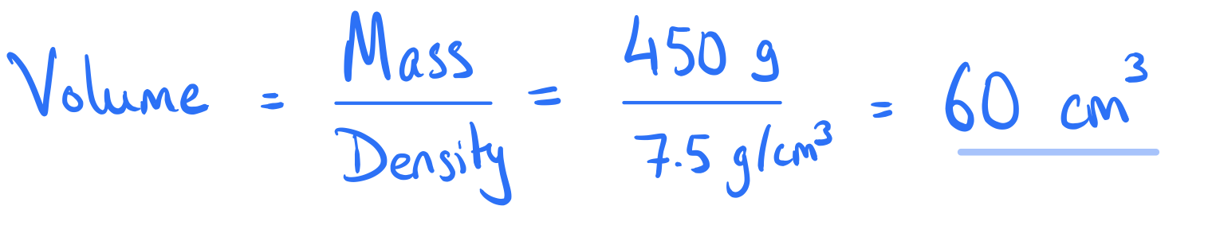
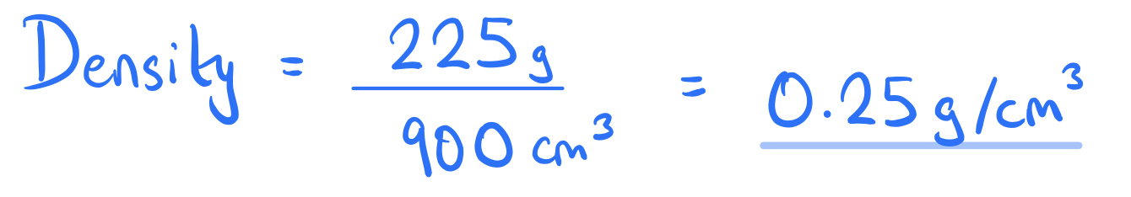


γ
Gamma Exercise
Solution
A cube of side 2 cm has a mass of 72 g. What is the density of the cube?
Platinum has a density of 21.4 g/cm³. How much does 1 m³ of platinum weigh?
What is the volume of an object that weighs 450 g and has a density of
7.5 g/cm³?
A ball with a volume of 900 cm³ has a mass of 225 g. What is the density of the ball? Will this ball float on water? (Water has a density of 1 g/cm³.)
Solution
Solution
Solution

Slide 10

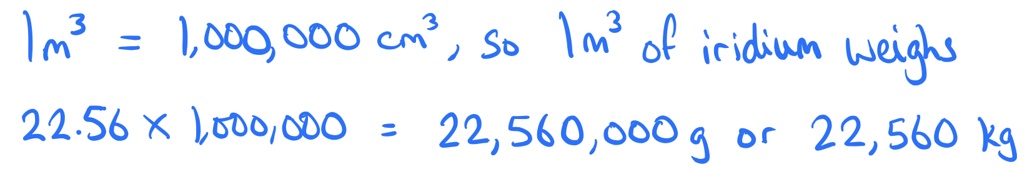
Explain the mistake
Denise answers this question as follows:
Iridium has a density of 22.56 g/cm³. How much does 1 m³ of gold weigh? Give your answer in kg.
Each cm³ of iridium weighs 22.56 g.
So 100 cm³ weighs 22.56 x 100 = 2256 g.
Therefore 1 m³ of iridium weighs 2256 g or 2.256 kg.
Denise has made a mistake. What is it?
Answer

Slide 11
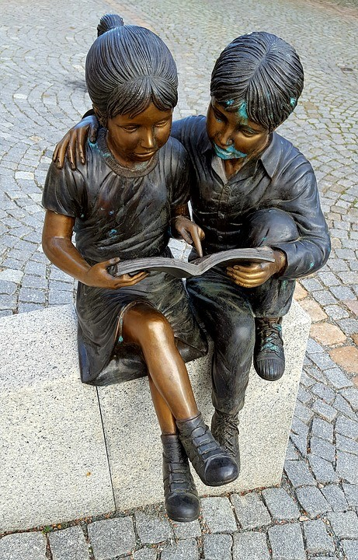


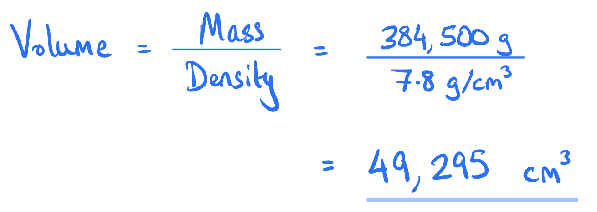

Exam-style question
Wu has made a bronze sculpture. The sculpture weighs 384.5 kg.
The density of the bronze used is 7.8 g/cm³. What is the volume of the sculpture, correct to the nearest cm³?
Solution

Slide 12
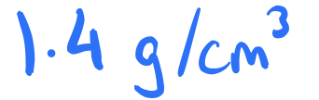
Challenge
A scientist has a measuring jug with a capacity of 800 cm³. The measuring jug weighs 90 g when empty.
The scientist adds 200 cm³ of liquid A and 600 cm³ of liquid B to the jug, so the jug is now full and has a mass of 850 g.
The mass of 200 cm³ of liquid A is equal to the mass of 350 cm³ of liquid B. What is the density of liquid A?
Answer

