Slide 1
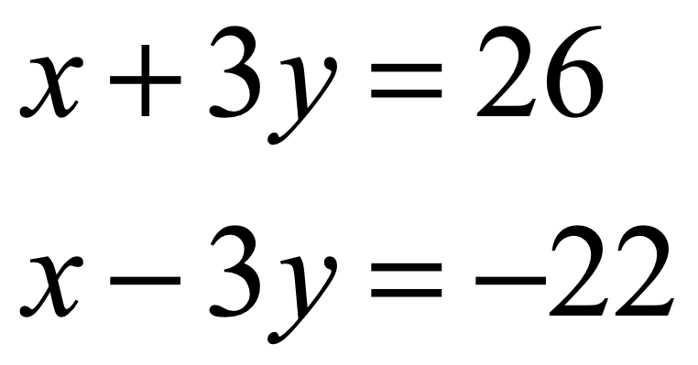
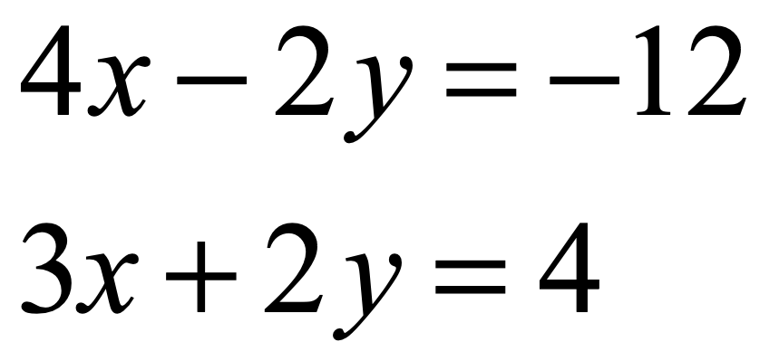
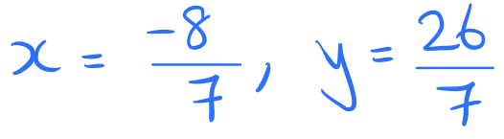
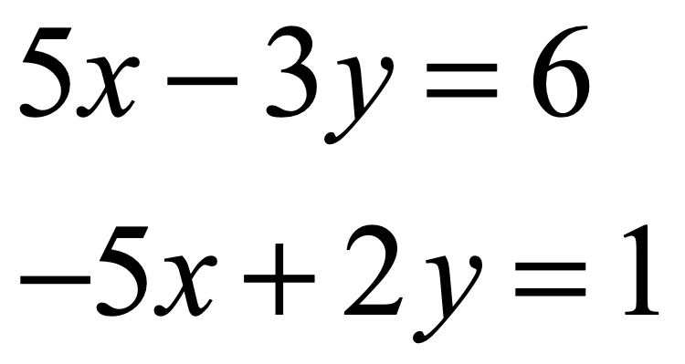
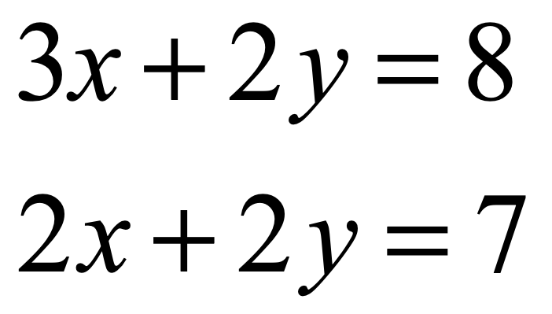
Warm-up activity
Solve the following pairs of simultaneous equations by elimination:
a)
b)
Answer
Answer
c)
d)
Answer
Answer

Slide 2
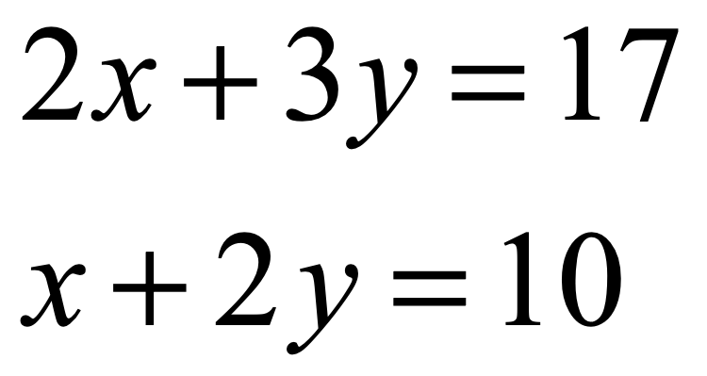
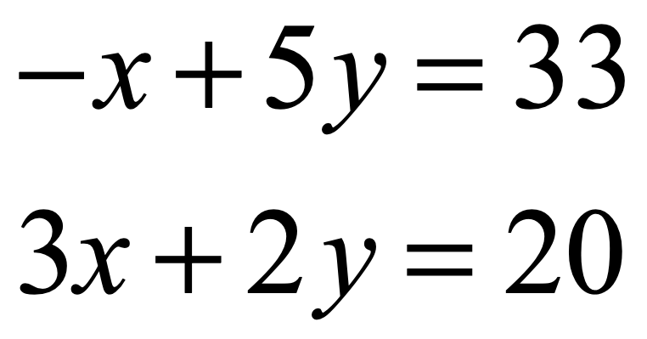
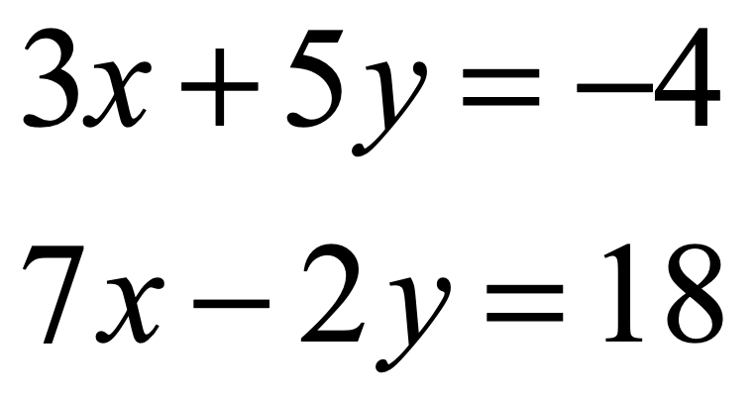
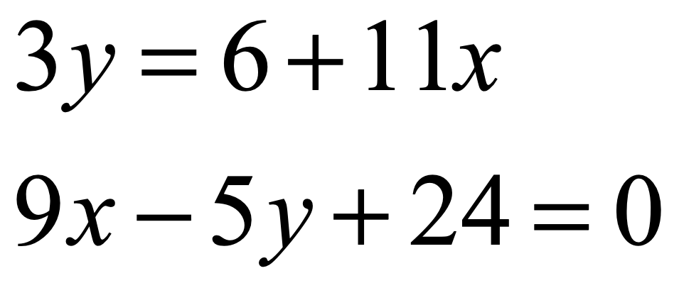
Examples
Solve the following pairs of simultaneous equations by elimination:
a)
b)
c)
d)

Slide 3
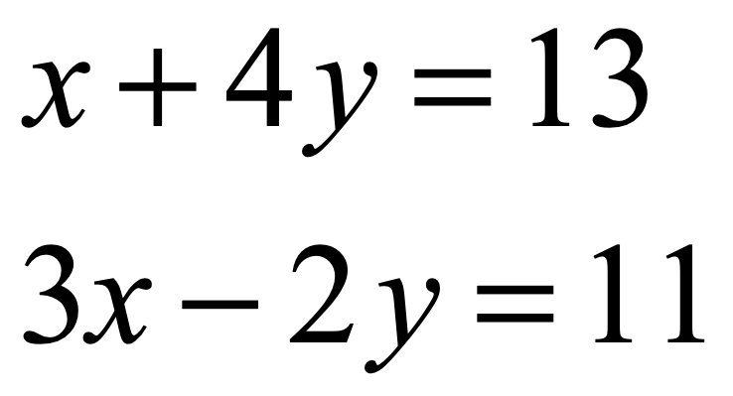
Diagnostic
Before adding the two equations, a good first step would be to:
a)
Multiply the first equation by 2
b)
Multiply the second equation by 3
c)
Divide the first equation equation by 3
d)
Multiply the second equation by 2

Slide 4
Diagnostic
x = 5, y = 2 is a solution to the above pair of simultaneous equations:
a)
True
b)
False

Slide 5
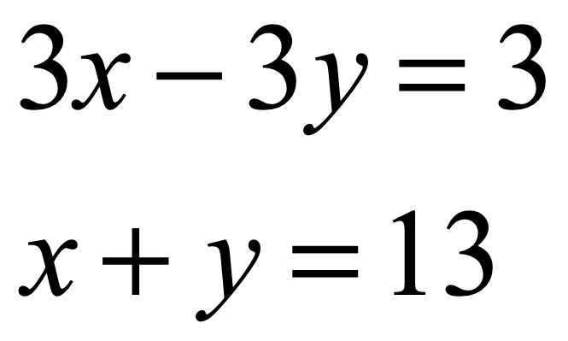
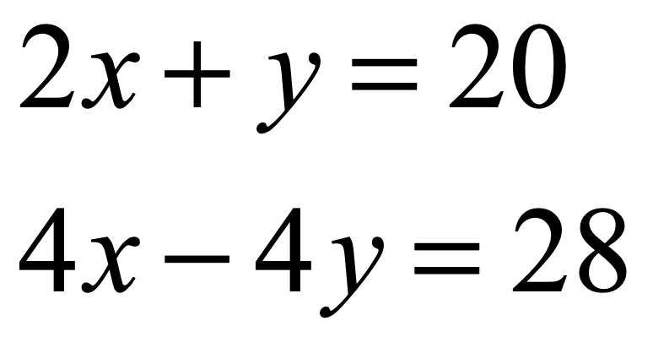
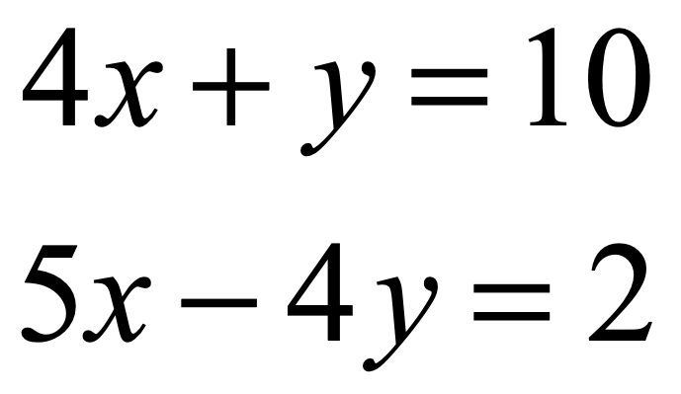
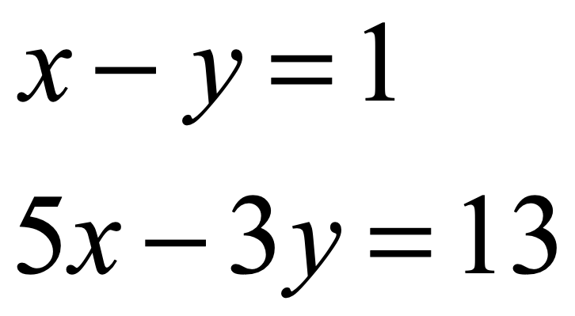
Alpha Exercise 1
α
Solve the following pairs of simultaneous equations by elimination:
a)
b)
Answer
Answer
c)
d)
Answer
Answer

Slide 6
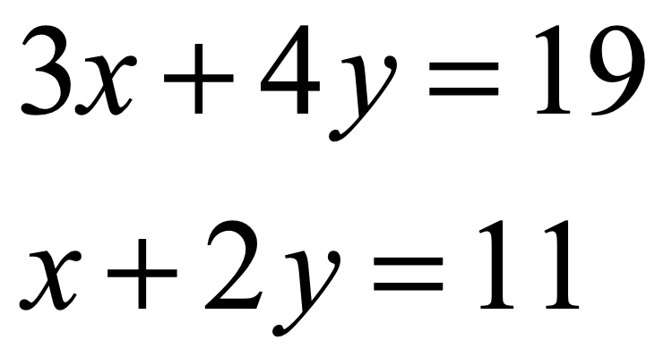
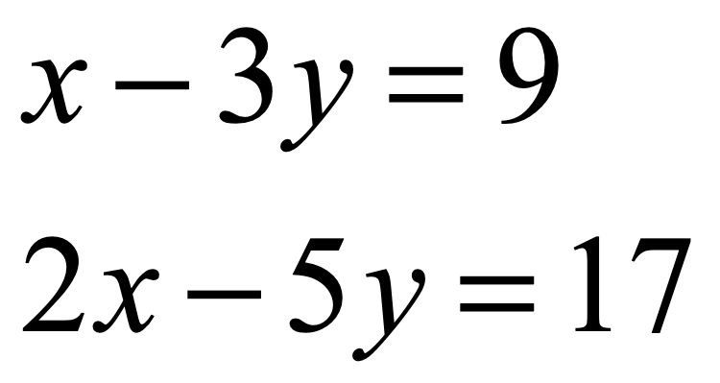
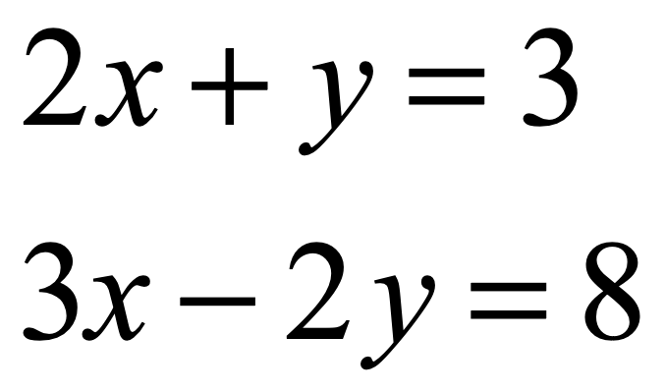
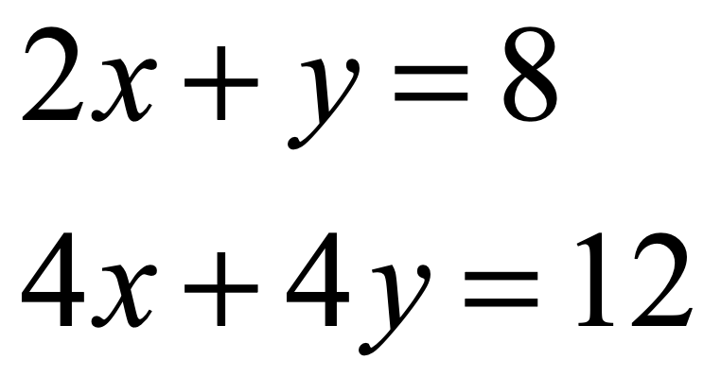
Alpha Exercise 2
α
Solve the following pairs of simultaneous equations by elimination:
a)
b)
Answer
Answer
c)
d)
Answer
Answer

Slide 7
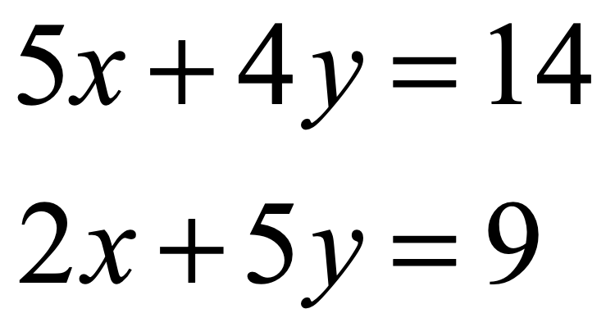
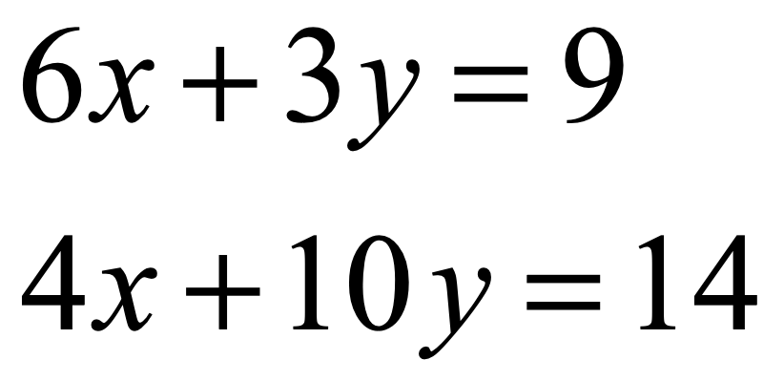
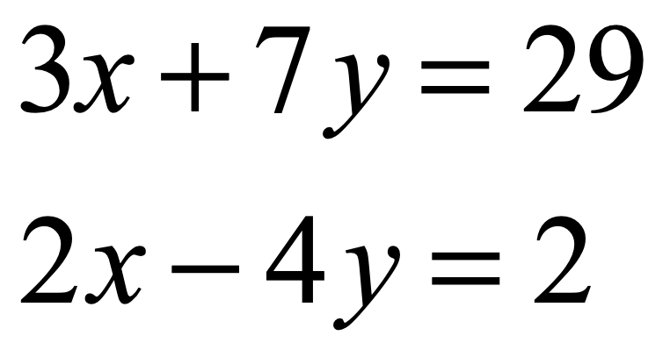
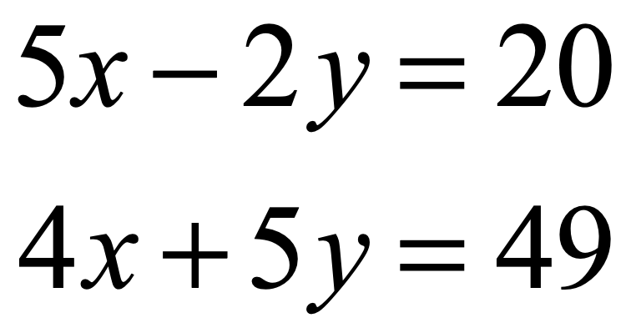
Beta Exercise 1
β
Solve the following pairs of simultaneous equations by elimination:
a)
b)
Answer
Answer
c)
d)
Answer
Answer

Slide 8
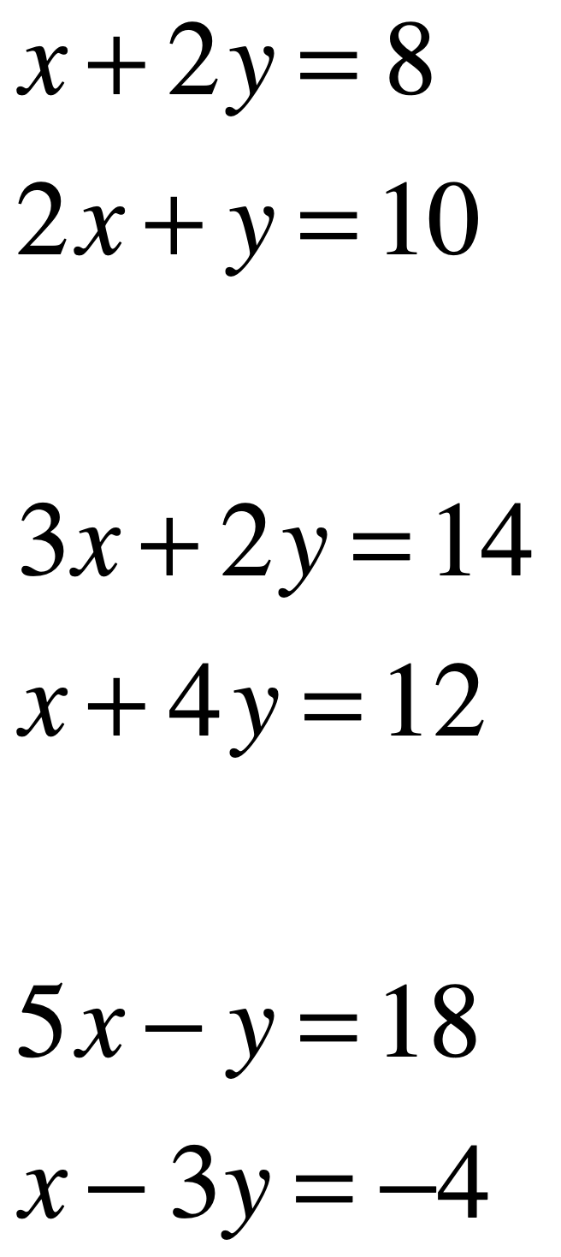
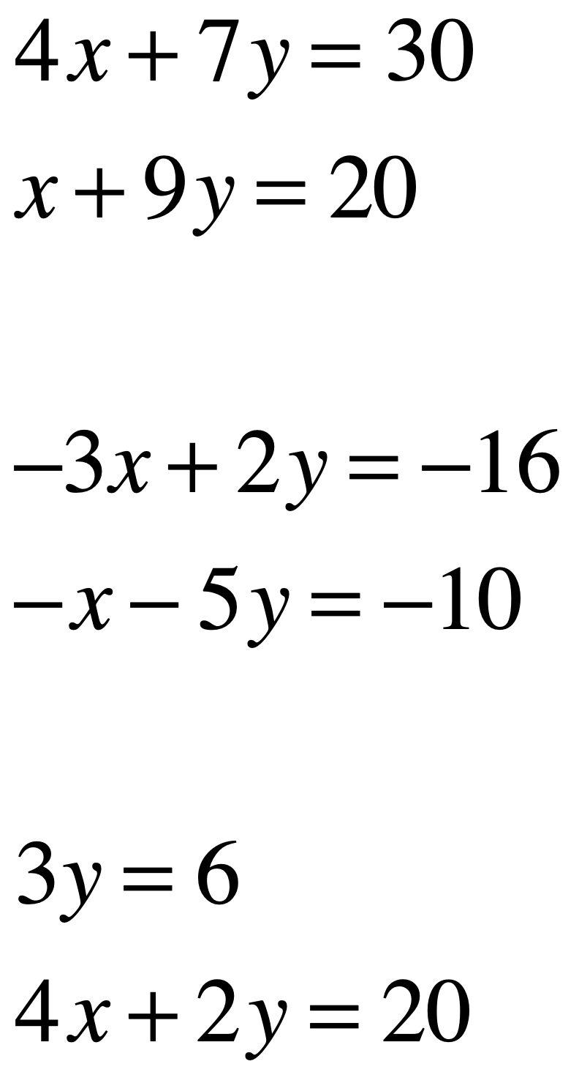
Beta Exercise 2
β
Work out whether x = 4, y = 2 is a solution
to each pair of simultaneous equations.
a)
d)
Answer
Answer
b)
e)
Answer
Answer
c)
f)
Answer
Answer

Slide 9
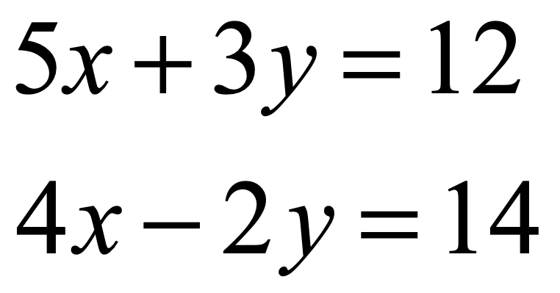
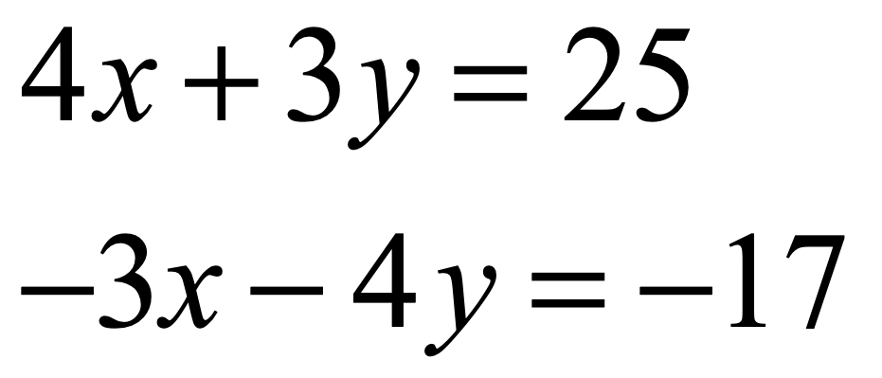
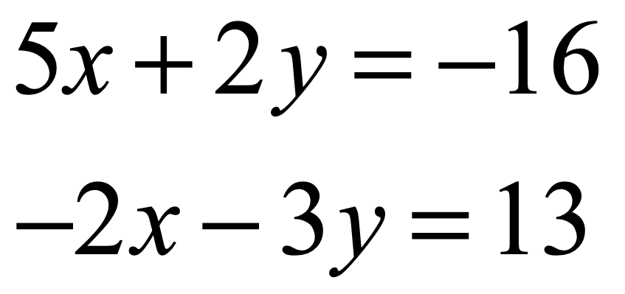
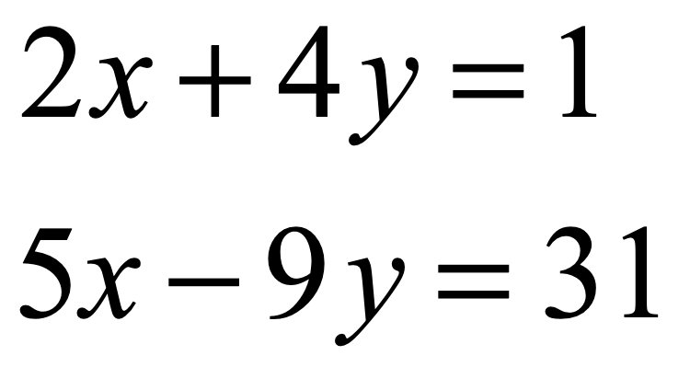
Gamma Exercise
γ
Solve the following pairs of simultaneous equations by elimination:
a)
b)
Answer
Answer
c)
d)
Answer
Answer

Slide 10
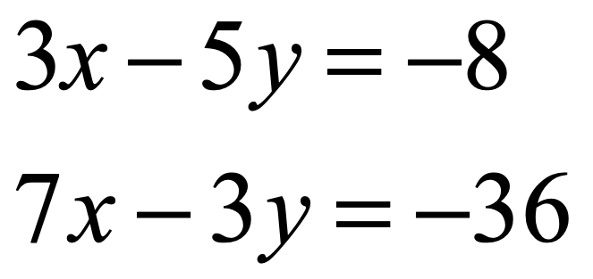
Explain the mistake
Joseph starts to solve this pair of simultaneous equations as follows:
Multiplying the first equation by 3 and the second by 5, we get:
9x - 15y = -24
35x - 15y = -180
Adding these, we get 44x = -204
…
Answer
Joseph has already made a mistake. What is it?

Slide 11
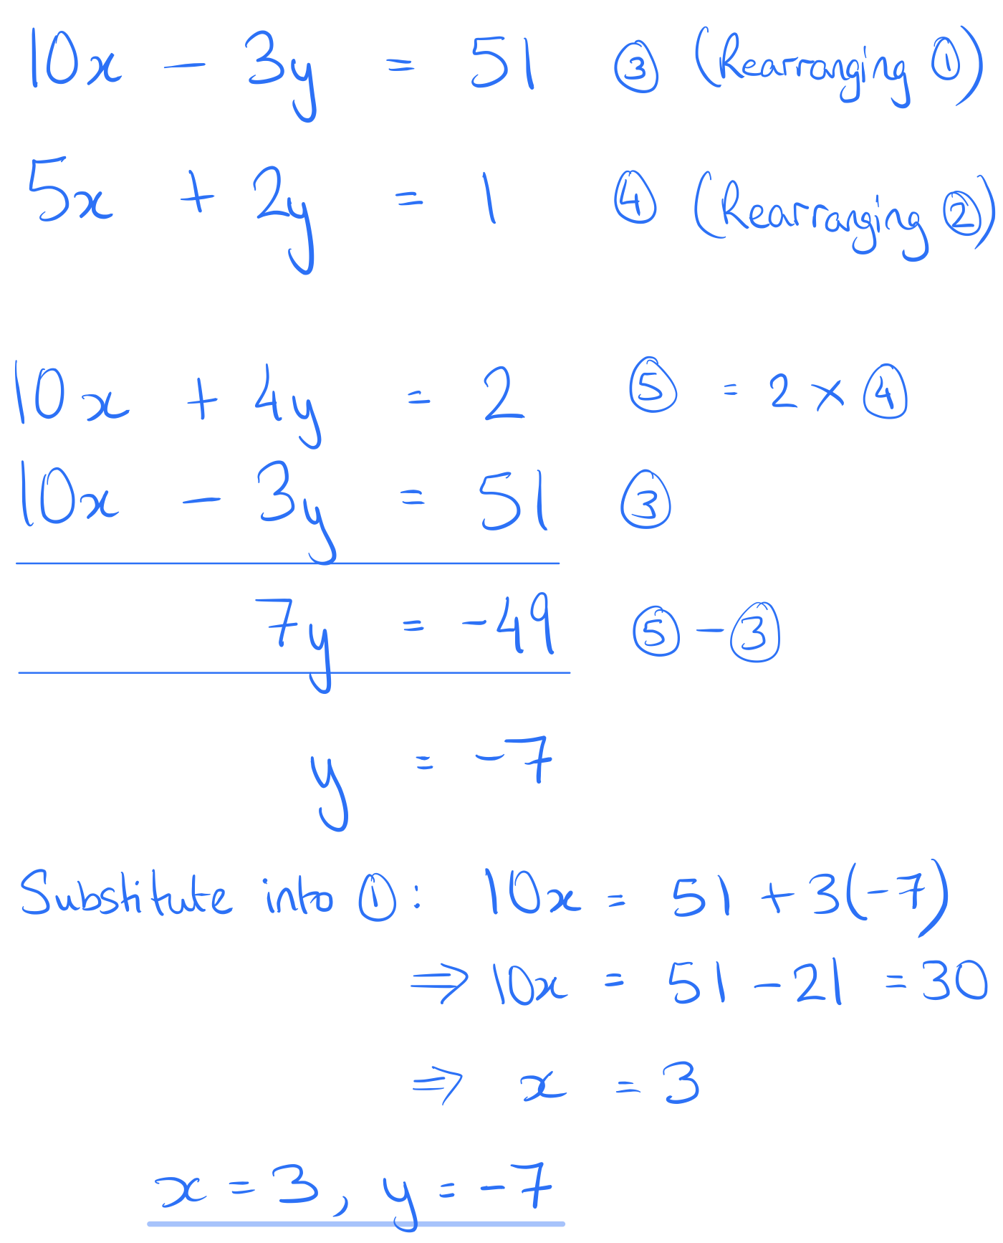
Exam-style question
Solution
Solve the following simultaneous equations:
10x = 51 + 3y
5x + 2y − 1 = 0

Slide 12
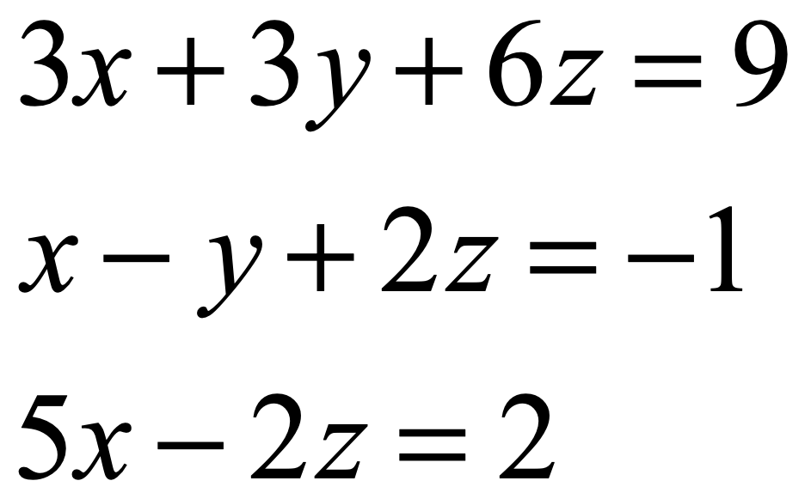
Challenge
Solve this set of simultaneous equations:
Answer

