Slide 1

Christmas Quiz
2023

Slide 2


Round 1
Film & TV

Slide 3
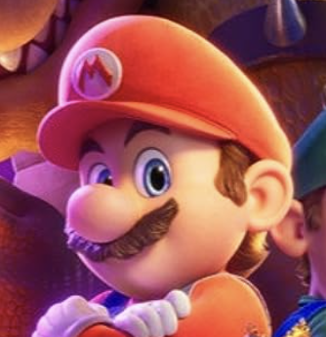
Question 1
The _____ _____ ____ Movie featured the voice of Jack Black playing a villainous King and Anya Taylor-Joy voicing a Princess with a fruity name.
The main character is a moustachioed plumber who is usually dressed in red and blue.
Clue 1
Clue 2

Slide 4

Question 2
Who was cast as the Fifteenth Doctor in the BBC series Doctor Who, taking over from David Tennant’s Fourteenth?
He appeared as Eric in a smash hit Netflix series from 2019-2023.
Clue

Slide 5

Question 3
Which 2023 epic film is named after an American theoretical physicist known for his part in developing the atomic bomb?
Clue 2
The film stars Cillian Murphy and Emily Blunt.
Clue 1

Slide 6
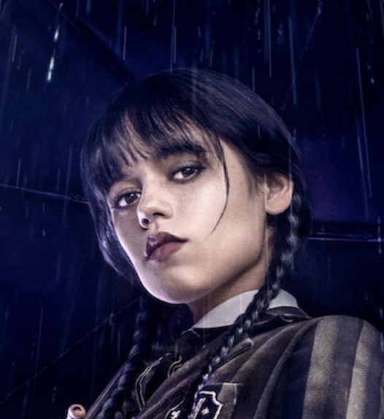
Question 4
Which Netflix series won the award for Best Television Series—Musical or Comedy at the 2023 Golden Globes?
Clue 1
Clue 2
The series featured a dance scene that inspired countless viral videos at the end of 2022 and start of 2023.

Slide 7

Question 5
Clue 2
It starred Margot Robbie and Ryan Gosling.
The film’s name is the name of the children’s dolls on which it is based.
Clue 1

Slide 8

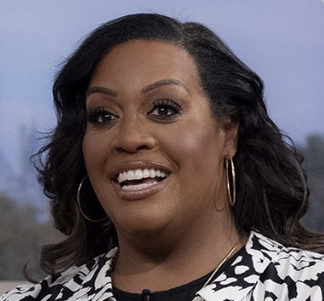
Question 6
What is the name of the presenter who joined The Great British Bake Off
in 2023, replacing Matt Lucas?
Clue

Slide 9
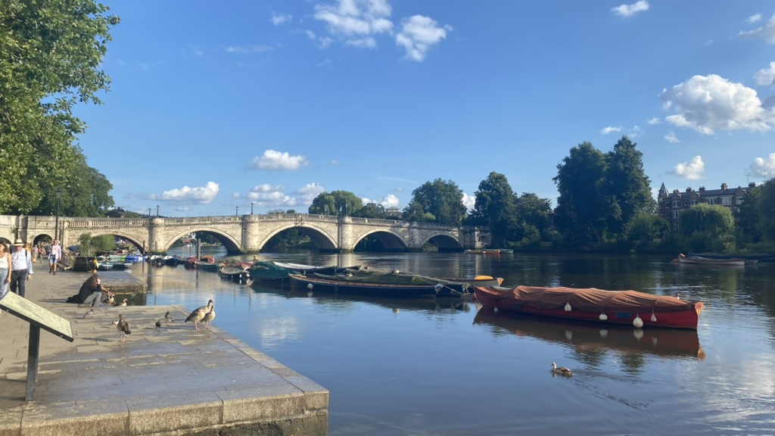
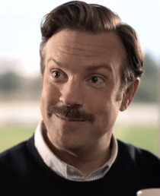
Question 7
What word is the surname of the manager of the fictional AFC Richmond football team?
Clue 1
Clue 2
Cowboys often use this loop of rope.

Slide 10
Question 8
Halle Bailey played The ______ _______ in this 2023 live-action Disney Film.
The film is a remake of the animated 1989 version, and features songs including Under the Sea.
Clue

Slide 11
BONUS CLUE
The first letters of your answers should spell out a wintry eight-letter word.
It is something you might throw.

Slide 12

Round 2
MUSIC

Slide 13
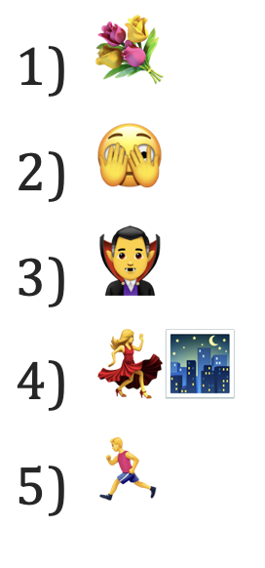
Music round
The emojis describe the titles of songs that were Number 1 in the UK charts at some point in 2023. In each case, name the song for one point and the artist for another point.

Slide 14
Round 3
NEWS

Slide 15
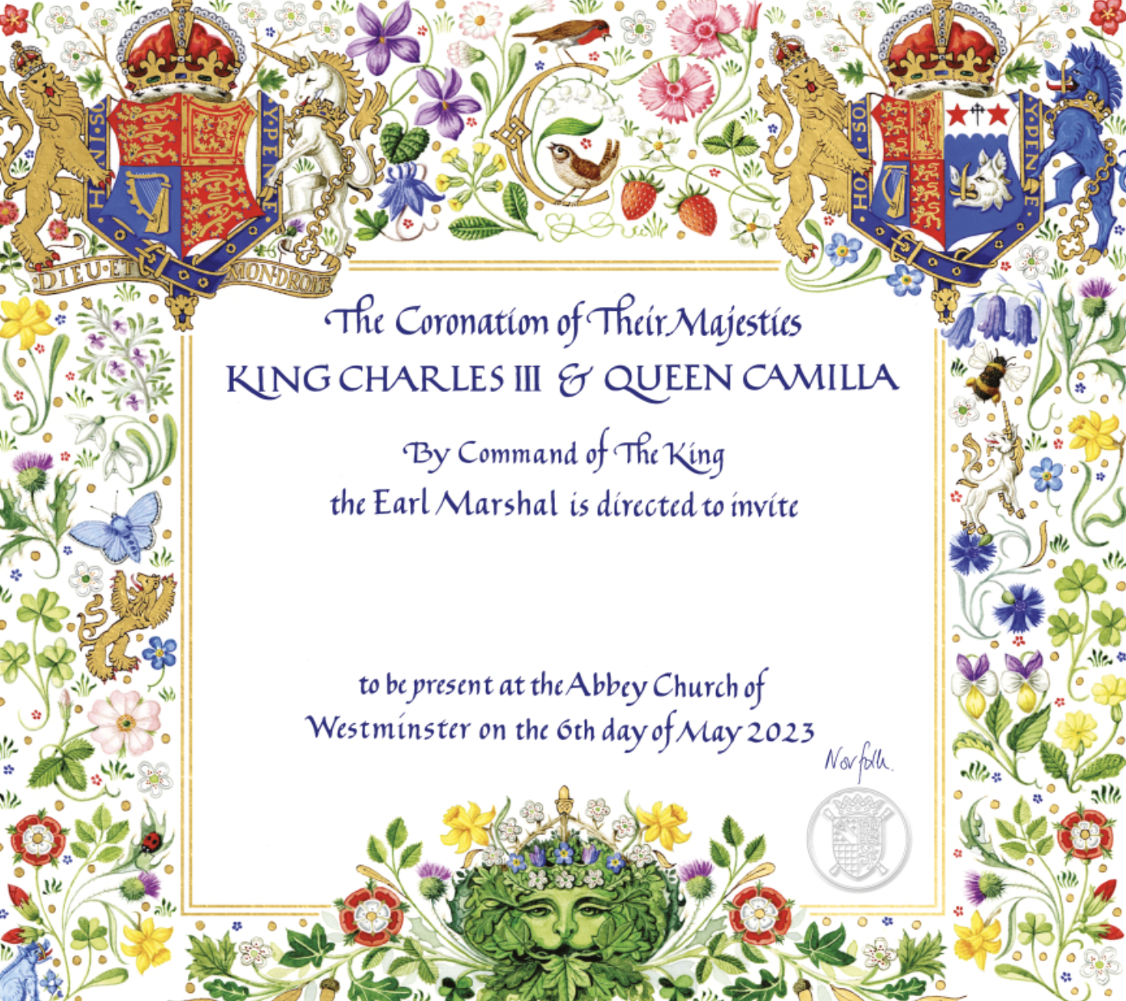
Question 1
Fill in the missing word:
The __________ was the reason for a Bank Holiday in the UK on Monday 8 May, even though this event took place on Saturday 6 May.

Slide 16
Question 2
For which UK Government Department is James Cleverly the Secretary of State?
His immediate predecessor was Suella Braverman.
Clue

Slide 17
Question 3
What word was named word of the year 2023 by the publishers of the Oxford English Dictionary?
Clue
It is a colloquial word, defined as style, charm, or attractiveness.

Slide 18
Question 4
At the start of 2023, the Prime Minister announced that halving _________ was the first of his five priorities.
Clue
This is a term that refers to the rising cost of goods and services.

Slide 19
Question 5
Fill in the blank:
The vessel stationed in a Dorset port that is intended to house over 500 asylum seekers is known as the Bibby _________.
Clue 1
Clue 2
The word is the name of a city.
The city is the capital of a Scandinavian country.

Slide 20
Question 6
Who was named Time Magazine’s Person of the Year 2023?
(First name and surname)
This person’s surname is a synonym of quick or fast.
Clue 1
Clue 2
This person was born in 1989.

Slide 21

Question 7
In which month did OpenAI launch ChatGPT-4?
Clue
The launch happened on pi day.

Slide 22
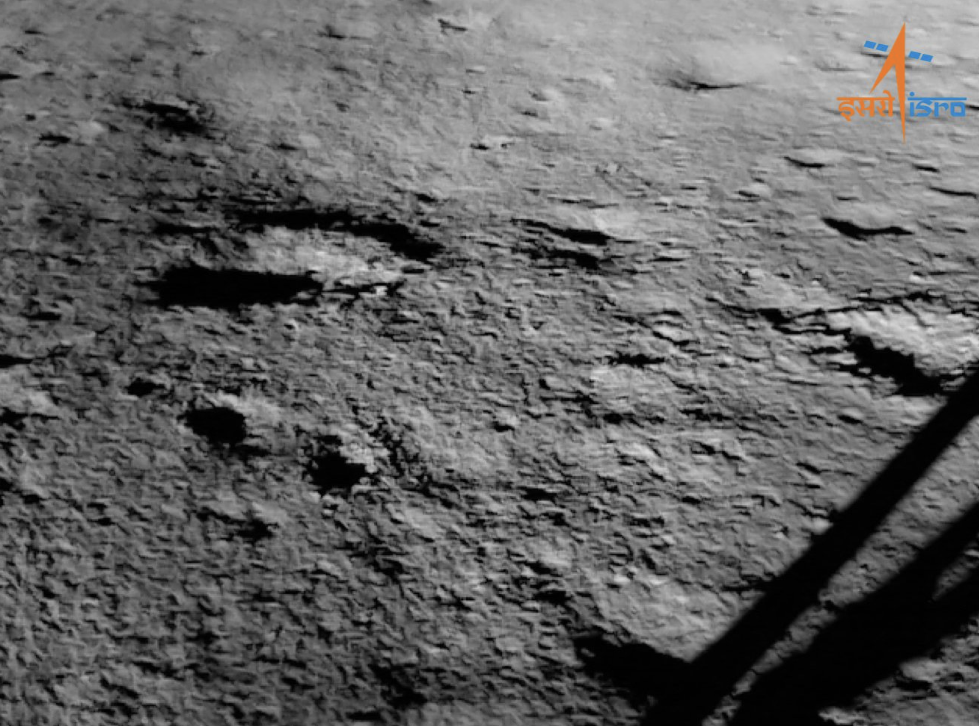
Question 8
In which month did Chandrayaan-3 become the first spacecraft to land near the south pole of the Moon?
Clue
It was during our summer.

Slide 23
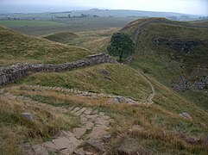
Question 9
A solitary Acer pseudoplatanus tree standing next to Hadrian’s wall was felled in September 2023. The tree famously featured in Robin Hood: Prince of Thieves.
What is the common English name for Acer pseudoplatanus?
Clue 2
It is a colloquial word, defined as style, charm, or attractiveness.
Clue 1

Slide 24
BONUS CLUE
The first letters of your answers to this round should spell out a festive nine-letter word.

Slide 25
Round 4
SPORT

Slide 26
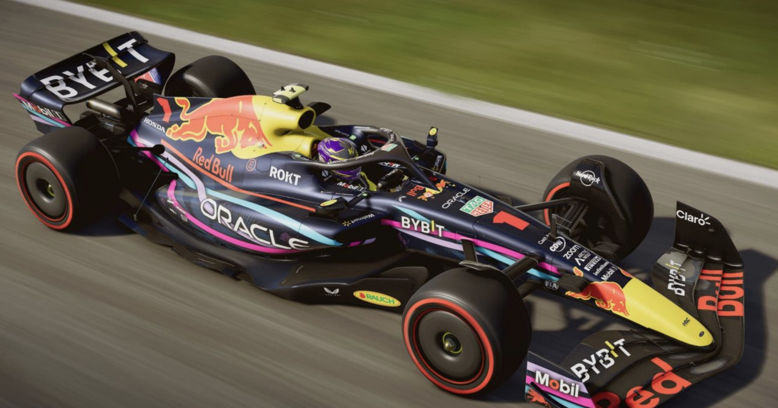
Question 1
Which driver won 19 out of the 22 races in the 2023 Formula One season?
(First name and surname)
Clue

Slide 27

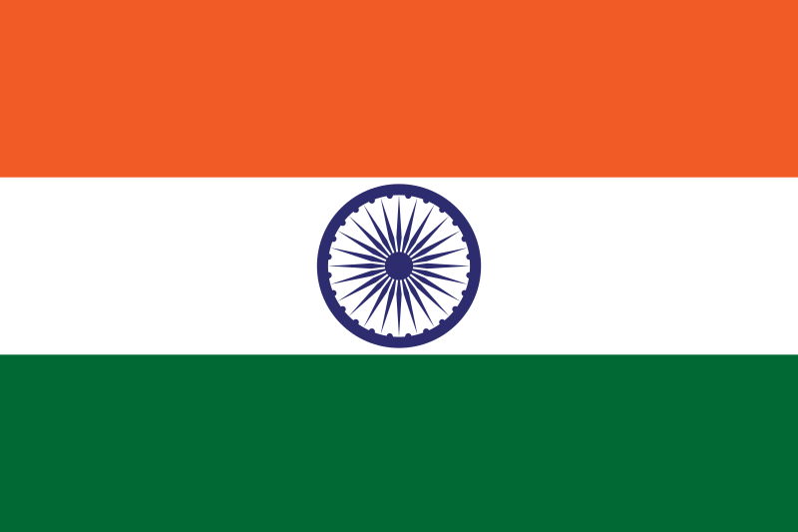
Question 2
Which team won the most matches at the 2023 Men’s Cricket World Cup, but did not win the tournament?
Clue 1
Clue 2
This country hosted the tournament.

Slide 28
Question 3
Who was England's player of the series in 2023 Women’s Ashes?
(First name and surname)
The Natmeg cricket shot is named after her.
Clue 2
Clue 1
The maiden name of her wife—also an England cricketer—was Katherine Brunt.

Slide 29

Question 4
Who won the Women’s Singles at the 2023 US Open tennis championships?
(First name and surname)
Clue 1
This American was aged just 19 when she won the tournament.
Clue 2
She goes by the same first name that Chanel went by.

Slide 30
Question 5
Which country lost to Spain in the final of the 2023 Women’s FIFA World Cup?
Clue 1
Clue 2
They are the reigning European Champions.
They are nicknamed the Lionesses.

Slide 31

Question 6
Which city is set to host the Summer Olympics in 2024?
This capital city is about 200 miles away from the host of the 2012 Games.
Clue 2
Clue 1
The 2012 Games were hosted by London.

Slide 32
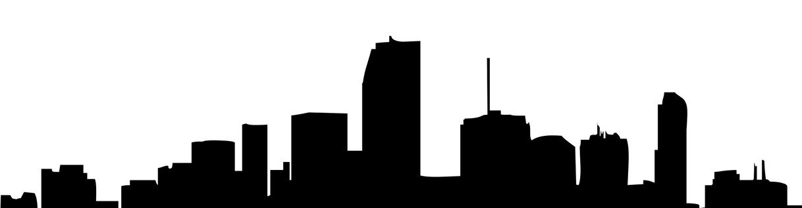
Question 7
As of December 2023, for which club does the winner of football’s Ballon d’Or play?
Clue 1
The Ballon d’Or winner is Argentine.
Clue 2
The club is co-owned by David Beckham, and is located in Florida.

Slide 33
Question 8
Which footballer was top scorer in England’s Premier League in 2022-23? He scored a record 36 league goals in the season.
(First name and surname)
Clue 1
Clue 2
He is Norwegian.
He plays for Manchester City.

Slide 34
Question 9
Which country won the 2023 men’s Rugby World Cup?
Clue 1
Clue 2
They beat the All Blacks in the final.
They are nicknamed the Springboks.

Slide 35
BONUS CLUE
The first letters of your answers to this round should spell out a two-word edible Christmassy treat.

