Slide 1
Christmas Quiz
2024

Slide 2
Round 1 NEWS

Slide 3
BONUS CLUE
The first letters of your answers to Round 1 should spell out a Christmassy eight-letter word.

Slide 4
Question 1
Bashar al-Assad recently fled his country and was granted political asylum in Russia.
Of which country was he president until his regime collapsed?
Clue 1
Clue 2
It is bordered by Türkiye, Iraq, Jordan, Israel, and Lebanon.

Slide 5
Question 2
Which social media network is set to banned in the USA from 19 January 2025, unless a legal appeal by its parent company succeeds?
Clue
The social network’s logo resembles a quaver (but not the crispy kind).

Slide 6
Question 3
In late 2024, it was announced that the world’s oldest Sunday newspaper The ________ will be sold to Tortoise Media.
Clue 1
It is currently the sister paper to The Guardian.
Clue 2
The answer is an anagram of soreverb.

Slide 7
Question 4
2024 has been the year of AI.
What has been the most widely used generative AI chatbot of the year?
Clue
This was developed by a company called OpenAI.

Slide 8
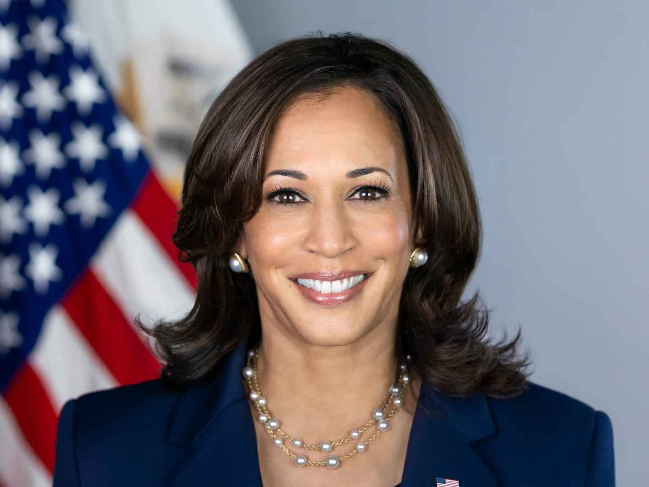
Question 5
Republican nominee Donald Trump was elected the next President of the United States in November 2024.
Who was his Democrat opponent?
(First name and last name)
Clue 1
Clue 2
The answer is an anagram of shark malaria.

Slide 9
Question 6
Eight of the world’s ten most populated countries held national elections in 2024. Which country was the most populated democracy to hold national elections this year?
Clue 1
Clue 2
642 million people voted in this election.

Slide 10
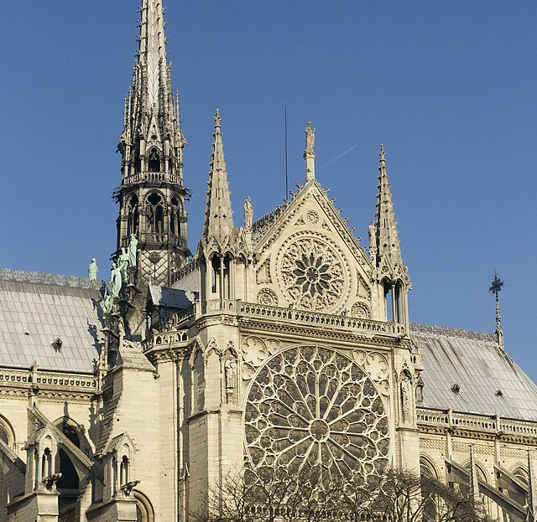
Question 7
Which famous Cathedral reopened in December 2024 following major fire damage in April 2019?

Slide 11
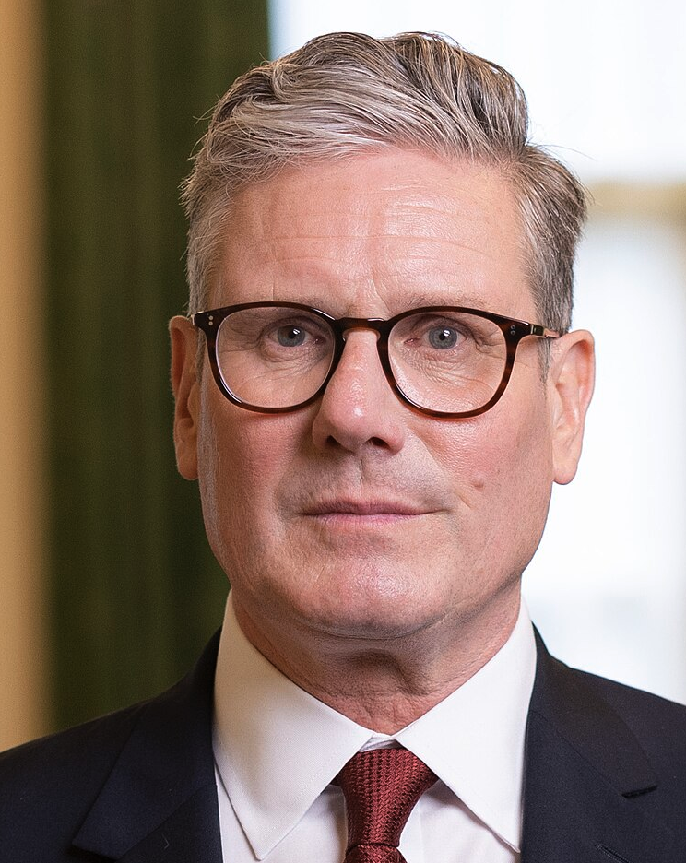
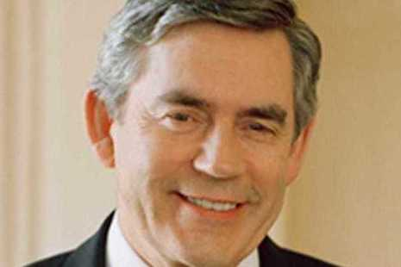
Question 8
Labour’s Keir Starmer became Prime Minister of the United Kingdom in 2024, following 14 years of Conservative Prime Ministers. Who was the previous Labour Prime minister?
(First name and surname)
Clue 1
Clue 2
The answer is not Tony Blair!

Slide 12
Round 2 musical anagrams

Slide 13
Musical ANAGRAMS round
Unscramble each pair. In each case, (a) is the title of a 2024 UK Number 1 single and (b) is the corresponding artist or band.
(Any punctuation and accents on letters have been ignored. In cases of artist collaboration, only the main artist is given.)
(a) MOST EXHALED [5,4,2] (b) BEEN COY [7]
(a) SEES PROS [8] (b) PRANCER ABSTAINER [7,9]
(a) ALSO SIGNOR[6,4] (b) ZEE PIG RIP [4,5]
(a) USES G[5] (b) XX RICH CAL[5,3]
(a) MR SALSA STITCH [4,9] (b) MWAH [4]

Slide 14
Round 3 Film & TV

Slide 15
BONUS CLUE
The first letters of your answers to Round 3 should spell out a festive eight-letter word.

Slide 16
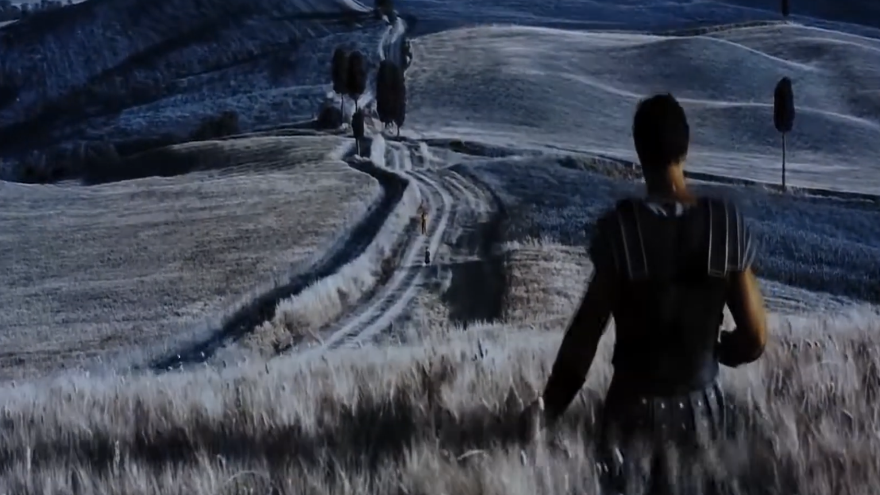
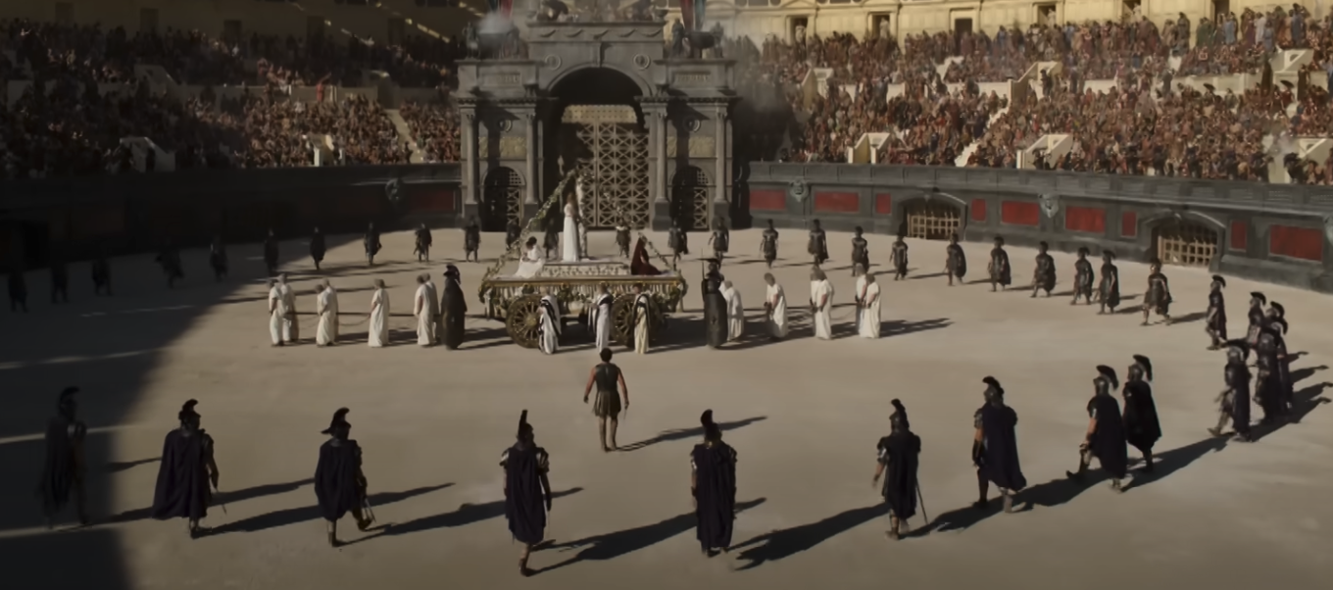
Question 1
Russell Crowe starred in a multi-Oscar-winning 2000 film.
Name its 2024 sequel.
Clue 2
Russell Crowe’s character was called Maximus Decimus Meridius
Clue 1

Slide 17
Question 2
In 2024, which film became the highest-grossing animated film of all-time, as well as the highest-grossing film of the year?
It is the sequel to a 2015 film about a character called Riley who is moving house…
Part of the clue…
…and her emotions.
...the rest of the clue

Slide 18
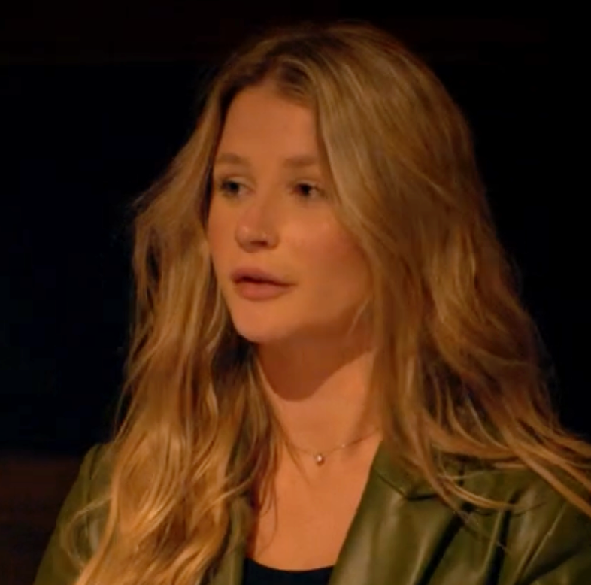
Question 3
Was this contestant on The Traitors a “traitor” or a “faithful”?

Slide 19
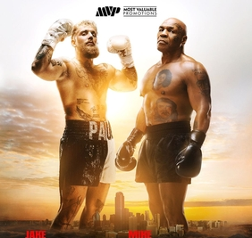
Question 4
Clue
Fill in the blank:
YouTuber Jake Paul fought former World Heavyweight Champion boxer Mike _____ in November 2024.

Slide 20
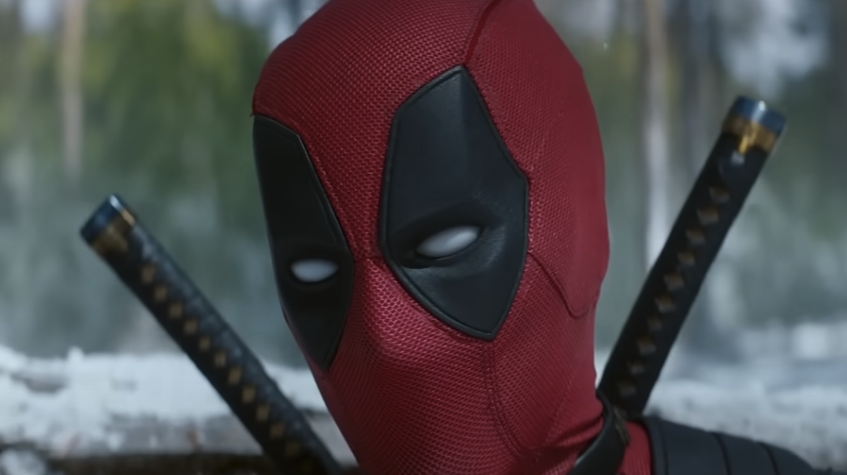
Question 5
Fill in the blank:
Deadpool and _________ was the third film in the Deadpool series.
Clue
Hugh Jackman plays this character.

Slide 21
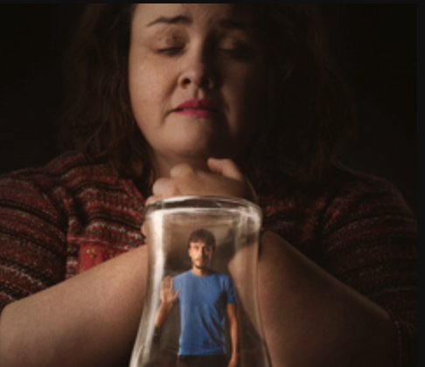
Question 6
Baby ________ was a controversial and multi-Emmy Award winning series released on Netflix in 2024.
Clue 1
What animal pulls Santa’s sleigh?
Clue 2

Slide 22
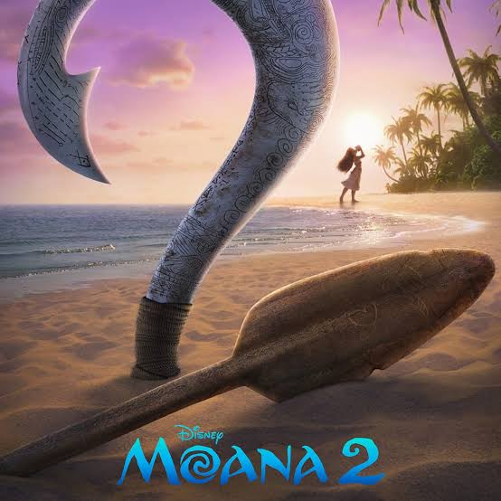
Question 7
Moana 2 was released in 2024.
You probably know the name of the person who voices the main supporting character, but who voices Moana?
(First name and surname)

Slide 23
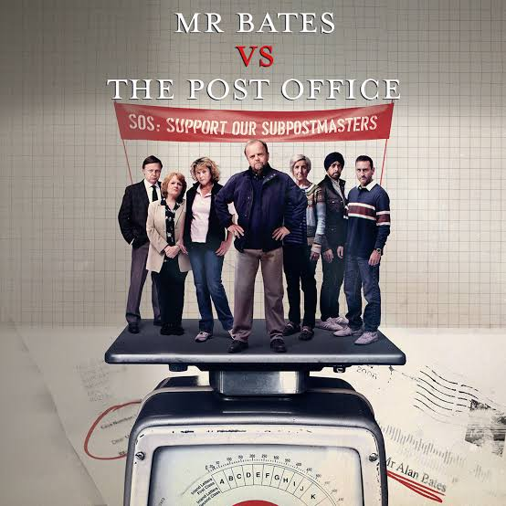
Question 8
A four-part ITV series shown in January drew public attention to a miscarriage of justice involving hundreds of people.
For which institution did the victims of this scandal work?

Slide 24
Round 4 SPORT

Slide 25
BONUS CLUE
The first letters of your answers to this round should spell out a wintry weather phenomenon.

Slide 26
Question 1
Which country won the Men’s Euro 2024 tournament?

Slide 27
Question 2
What is the nationality of the top scorer in the 2023-24 Premier League?
Clue 2
The 2023-24 top scorer was a Manchester City player.
Clue 1

Slide 28
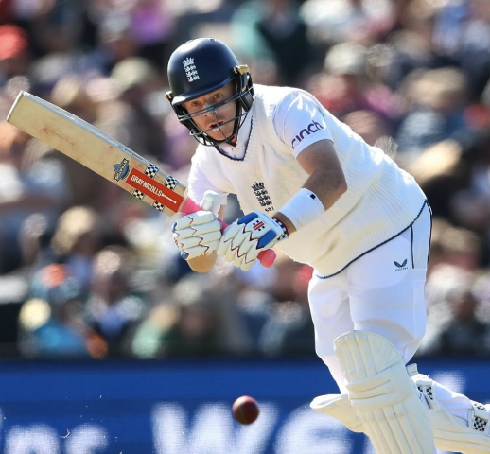
Question 3
Who deputised as England Men’s cricket captain in the absence of Ben Stokes in a number of Test matches this year?
(First name and surname)
His first name has been one of the most popular names for baby boys in England and Wales in recent years.
Clue 1
Clue 2
His surname is what the head of the Catholic church is most commonly known as.

Slide 29
Question 4
Which Grand Slam tournament did Barbora Krejčíková win in 2024?
Clue

Slide 30
Question 5
Ireland won the Six Nations Championship in 2024. Which country came second?
Clue
It was not a Home Nation.

Slide 31
Question 6
Who was voted England Women’s Player of the Year 2023-24 at the FA England Awards?
(First name and surname)
She currently plays club football for Arsenal, having previously played for Manchester United.
Clue

Slide 32
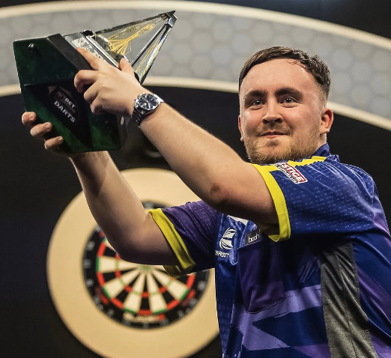
Question 7
Which 16-year-old took his sport by storm on his way to the final of the PDC World Darts Championship, held at the start of 2024?
(First name and surname)
Clue

Slide 33
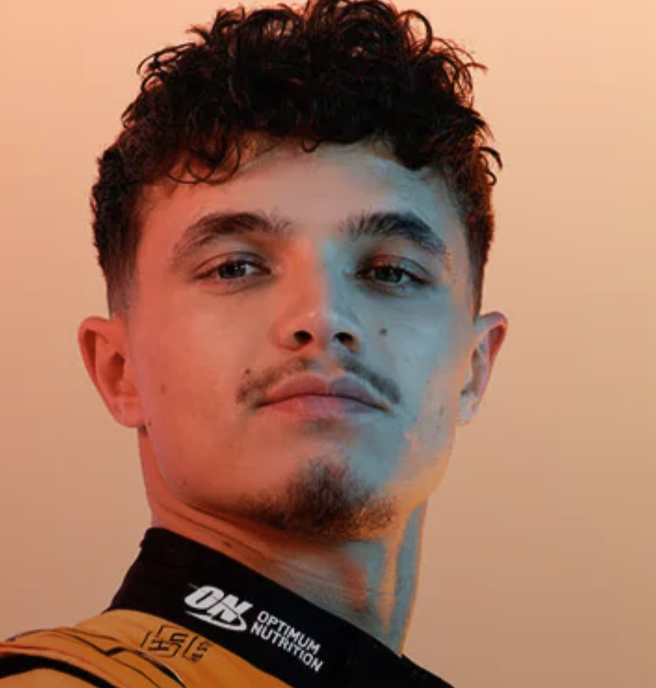
Question 8
Clue
Who finished runner up to Max Verstappen in the
2024 Formula 1
World Championship?
(First name and surname)

